Slide 1
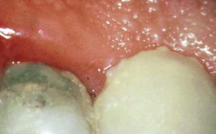
GINGIVAL INFLAMMATION

Slide 2
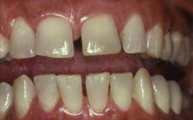
INTRODUCTION
Stage I Gingivitis(Initial lesion)
Stage II Gingivitis(Early lesion)
Stage III Gingivitis(Established lesion)
Stage IV Gingivitis(Advanced lesion)

Slide 3
STAGE I GINGIVITIS(INITIAL LESION)
First manifestation Vascular changes
Dilated capillaries Blood flow increased
Initial inflammatory changes due to microbial activation of resident leukocytes & subsequent stimulation of endothelial cells
Subclinical gingivitis

Slide 4
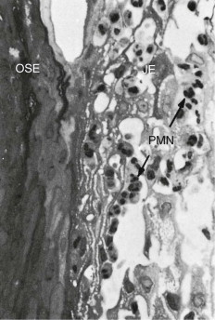
STAGE I GINGIVITIS(INITIAL LESION) Contd…
Microscopically:
-widening of small capillaries/venules
-adherence of neutrophils to vessle walls
(margination)-1wk/early as 2 days after plaque accumulation
-PMNs(diapedesis,emigration) –CT,JE&GS
-Exudation of fluid from GS&extravascular
protein are present

Slide 5
STAGE II GINGIVITIS(EARLY LESION)
Evolves from the initial lesion
After 1wk of plaque accumulation
Erythema
Bleeding on Probing
Gingival fluid flow
Transmigrating leukocyte maximum-6&12days

Slide 6
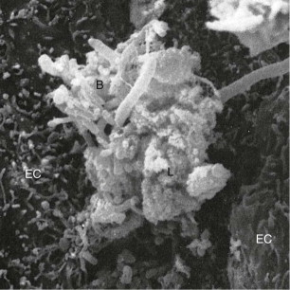
STAGE II GINGIVITIS(EARLY LESION)Contd…
Microscopic examination:
-Leucocyte(mainly Lymphocyte-75%T Cells)infilterate in CT below JE
-Some neutrophils,macrophages,plasma cells&mast cells
-JE densely infilterated with neutrophils&show development of rete pegs/ridges

Slide 7
STAGE II GINGIVITIS(EARLY LESION)Contd.
70%collagen destruction around cellular infilterate
Circular&Dentogingival group fibers mostly affected
PMNs reach in to pocket(chemotactic stimuli)
PMNs-phagocytosis(release of lysosomes to engulf bacteria)
MMPs-extracellular matrix remodelling(7days)

Slide 8
STAGE III GINGIVITIS(ESTABLISHED LESION)
2/3wk after accumulation of plaque
Predominance of plasma cells&B lymphocyte
Creation of small gingival pocket lined with pocket epithelium
B cells predominently IgG1&IgG3 subclasses
Vessels engorged ,congested&venous return impaired&blood flow sluggish
Result localized gingival anoxemia-bluish hue on the reddened gingiva

Slide 9
STAGE III GINGIVITIS(ESTABLISHED LESION contd..
Extravastion of erythrocyte in to CT&brekdown in to component pigments can deepen the color of inflamed gingiva
Collagenolytic activity increased in inflammed gingival tissue
Increased level of ALP,β-glucuronidase,glactosidase,glucocidase,esterase,aminopeptidase&cytochrome oxidase
Decreased neutral mucopolysaccharide

Slide 10
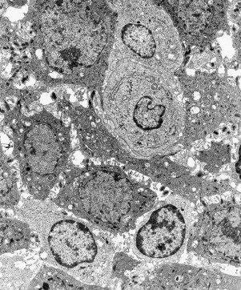
STAGE III GINGIVITIS(ESTABLISHED LESION contd..
Microscopically:
-Increased number of Plasma cells
-JE, widened intercellular spaces+granular cellular debries including lysosomes
-JE develop ridges/rete peges protrudes in CT
-Collagen fibers destroyed
This lesion is reversible after successful Periodontal therapy

Slide 11
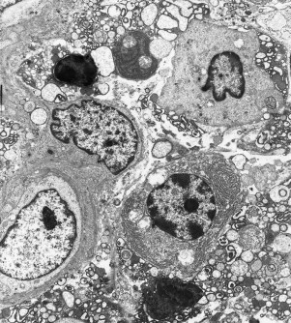
STAGE IV GINGIVITIS(ADVANCED LESION)
Phase of periodontal breakdown
Extension of lesion into alveolar bone
Higher IL-1β&lower IL-8 at 28days
Microscopic:
-fibrosis of gingiva
-widespread manifestation of inflammatory and immunologic tissue damage
-plasma cell dominates in CT
-neutrophils dominates JE

Slide 12
CONCLUSION
 | Time (days) | Blood vessels | JE&SE | Predominent cell | Collagen | C/F
Initial lesion | 2-4 | vasculitis | PMNs | PMNs | Perivascular loss | GCF flow
Early lesion | 4-7 | Vascular proliferation | Same as stage I rete pegs | Lymphocyte | Loss around infiltrate | Erythema BOP
Established lesion | 14-21 | As stage II +Blood stasis | As stage II +more advanced | Plasma cells | Continued loss | Changes in color,size&texture etc

Slide 13
MCQ-1
Which of the following clinical condition represents the non apparent initial response of the gingiva to bacterial plaque
(a)Subclinical gingivitis
(b)Marginal gingivitis
(c)Localized gingivitis
(d)Generalized gingivitis

Slide 14
MCQ-2
Which of the following leucocytes mainly predominant in the stage I gingivitis
(a)PMNs
(b)Plasma cells
(c)Lymphocytes
(d)Basophils

Slide 15
MCQ-3
Which of the following is related with clinical finding of the early lesion of gingivitis
(a)Gingival fluid flow
(b)Erythema
(c)Change texture of gingiva
(d)Change size of gingiva

Slide 16
MCQ-4
Which of the following cell is mainly present in the C.T.during stage II gingivitis
(a)Neutrophils
(b)Lymphocyte
(c)Plasma cell
(d)Macrophages

Slide 17
MCQ-5
Which group of the fiber is mostly affected in the early stage of gingivitis
(a)Circular
(b)Alveolar crest
(c)Horizontal
(d)Transseptal

Slide 18
MCQ-6
The localized gingival anoxemia which superimposes a some what bluish hue on the reddened gingiva is clinical feature of
(a)Initial lesion
(b)Early lesion
(c)Established lesion
(d)Advanced lesion

Slide 19
REFERENCES
Carranza’s Clinical Periodontology 11th Edition
Carranza’s Clinical Periodontology 12th Edition

